Slide 1
Barbara Johnson Stemler
Senior Manager of Access Programs
intrepidmuseum.org/access
bjohnson@intrepidmuseum.org
@bjohnnystemler
@IntrepidMuseum

Slide 2
Stories Within

Slide 3
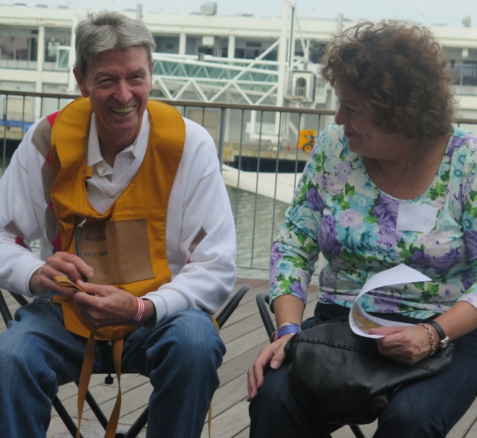

Slide 4
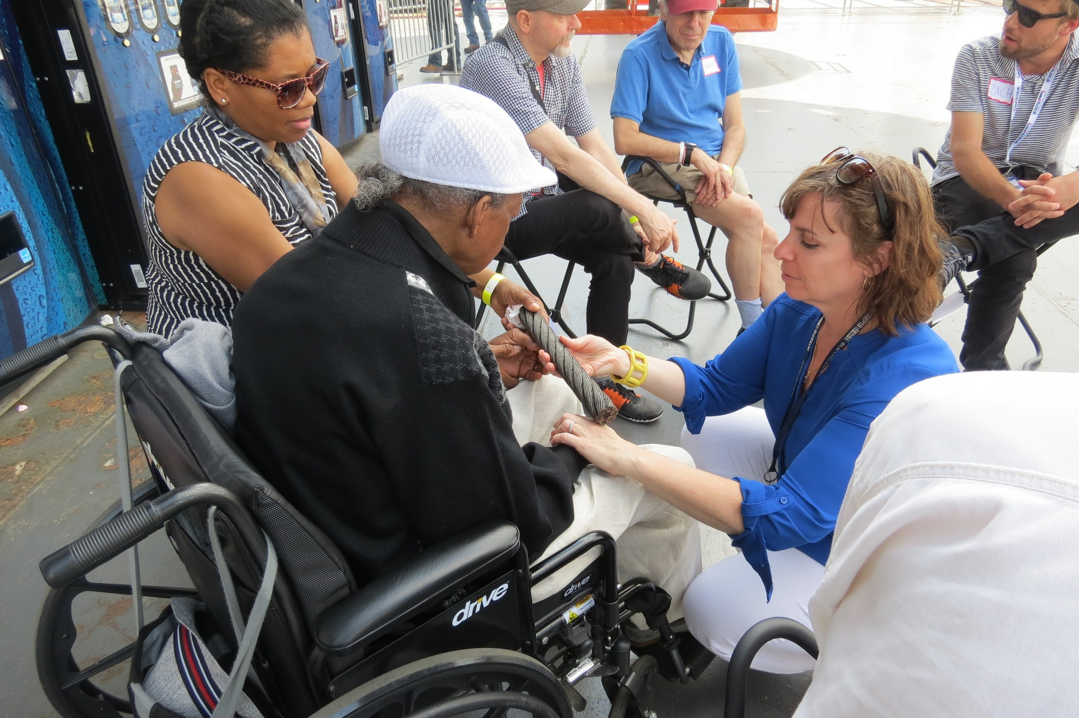

Slide 5
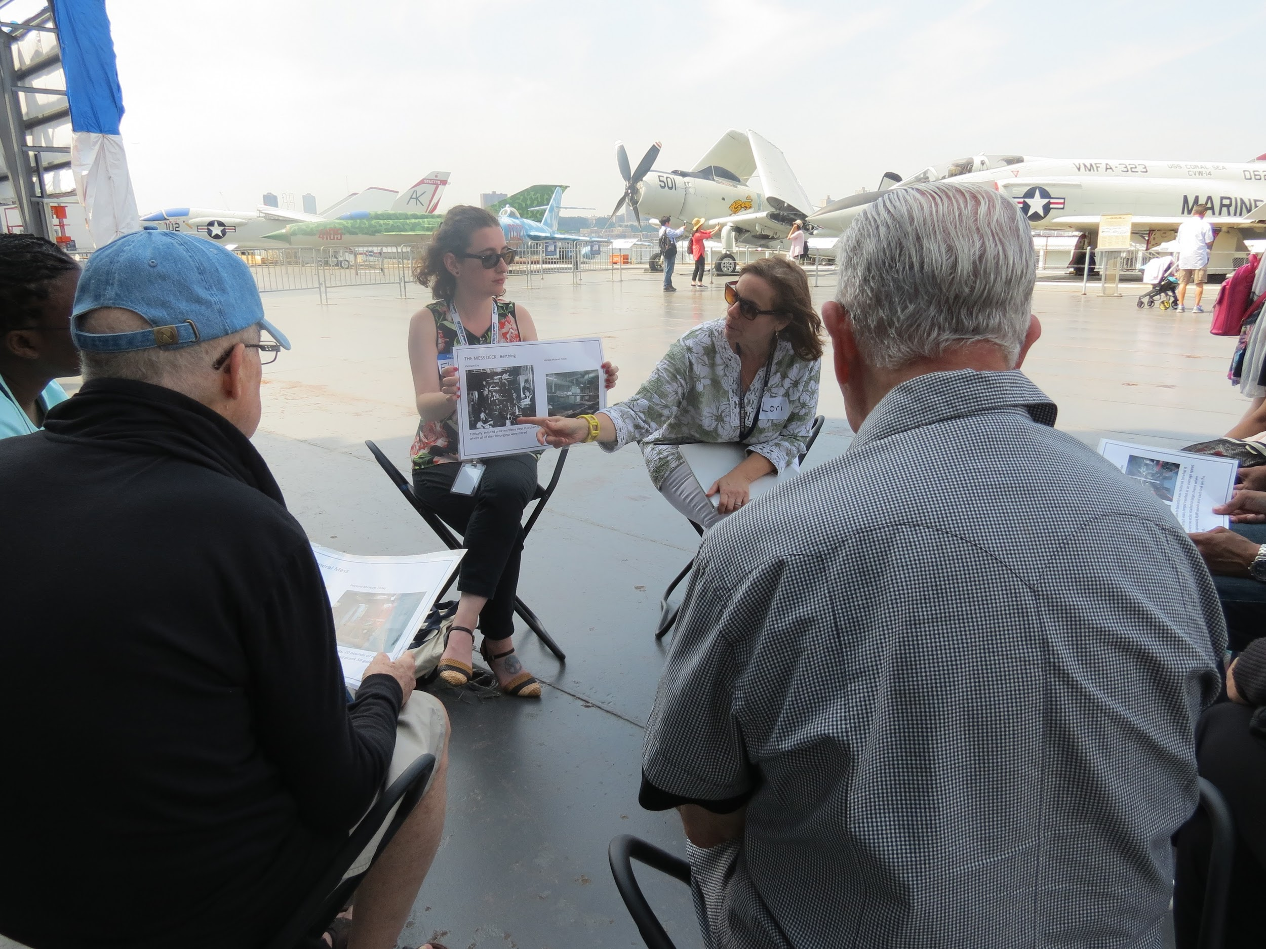

Slide 6
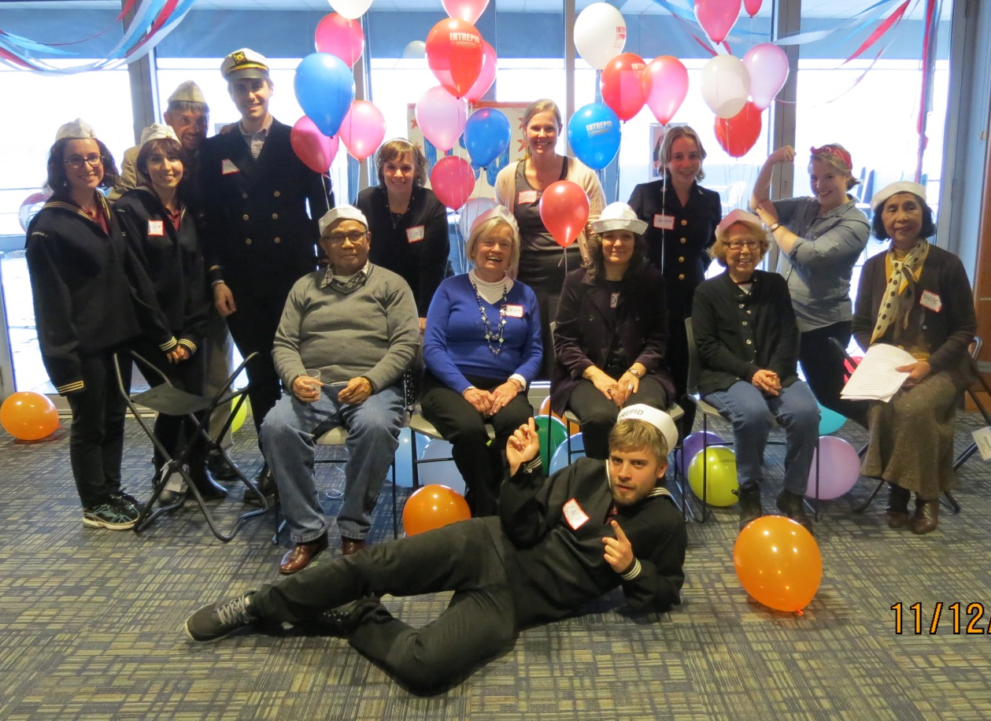
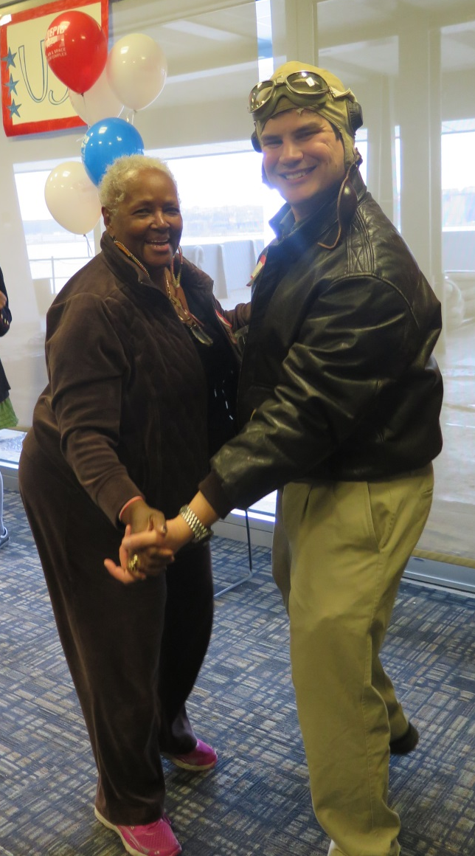
USO Dance

